Slide 1

Responsible AI Dashboard | Building a machine learning model? Learn to debug it with tools like error analysis, fairness assessment, interpretability and model performance - using a single pane of glass, on Azure.
Azure Content Safety | Building generative AI applications? Learn about prompt engineering, detecting jailbreaks, and filtering out harmful content – customizing criteria to suit your application context and requirements.
Prompt Flow On Azure ML | Learn to create an end-to-end executable workflow that links LLMs, vector embeddings, prompts, and data – using a visual graph editor. Evaluate & deploy to Azure for large-scale testing.
Self-Guided Workshops
Responsible AI Developer Hub: https://aka.ms/rai-hub/website
Learn Collection: https://aka.ms/rai-hub/collection
Notes:
To support this, Microsoft did 3 things:
- Define Responsible AI Principles that guide the approach to assessing, developing & deploying AI systems safely, reliably, and ethically.
- Created an open-source Toolbox that brings together an integrated collection of open-source tools (from Microsoft + Community) for operationalizing it.
- Developed a Responsible AI Dashboard to provide a single pane of glass for holistic assessment of your deployed model, using these tools

Slide 2

Train a model and debug it with Responsible AI Dashboard
Microsoft Learn Module
Responsible AI Dashboard (Website) https://aka.ms/rai-hub/dashboard-workshop
Nitya Narasimhan, PhD
Senior AI Advocate
Microsoft
@nitya | https://linkedin.com/in/nityan
Responsible AI Collection (Resources) https://aka.ms/rai-hub/collection
Notes:
Hello and welcome to this Learn Live Session.
Today we are going to learn how you can train a model and debug it for compliance with the Responsible AI principles – using the Responsible AI Dashboard integration in Azure Machine Learning Studio.

Slide 3
3 | Error Analysis On A Model
4 | Find Model Performance Inconsistencies
5 | Expose Data Biases
7 | Complete Exercises – Prioritize Dashboard Section
8 | Knowledge Check
6 | Explain & Interpret Model
1 | Prepare The Lab – Launch & Run Notebooks Early
9 | Summary
2 | What is a Responsible AI Dashboard?
Notes:
Welcome to the Learn Session for the Responsible AI Dashboard. This is our agenda for today. The Learn Module is designed for 20 minutes of “concepts” and 45 minutes of “lab”
In the workshop format, we can follow this agenda to ensure attendees complete the lab within an hour.
[5 mins] Start the Lab Preparation early before reviewing concepts. Lab setup takes 10 minutes, so we can use that time to review concepts.
[10 mins] Review Concepts while attendees wait for setup to complete. Use the 2-minute video, or walk through the slides and explain them
[35 mins] Let attendees get back to their Labs and complete the exercises on their own.
[5 mins] Do the knowledge check to review understanding – or use time for Q&A or extra buffer
[5 mins] Wrap-up and provide badges, resources

Slide 4
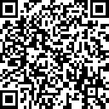
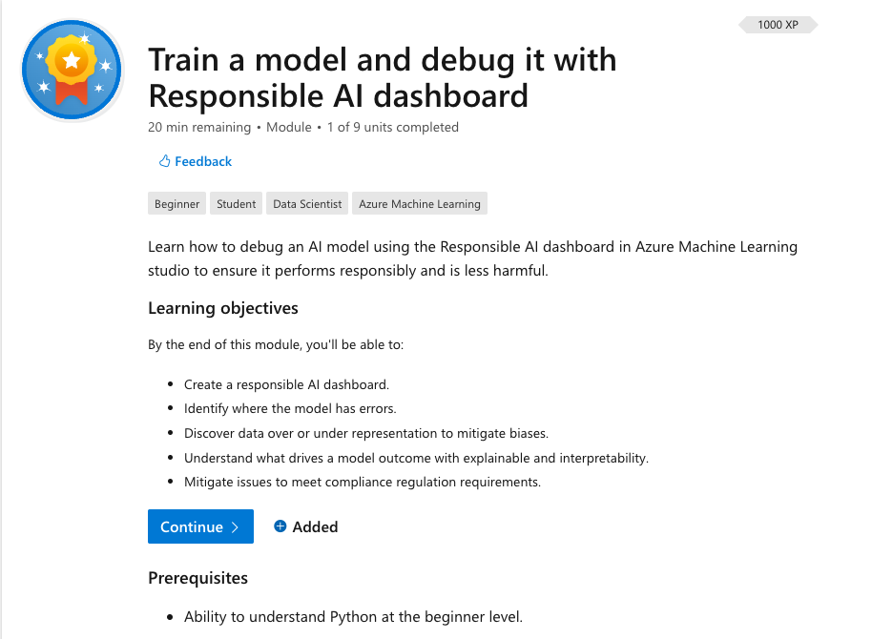
https://aka.ms/mslearn-responsibleai-dashboard
Launch This Lab!
Visit the link above to get access to the Microsoft Learn Training module shown
Notes:
Welcome to the Responsible AI Dashboard Training Session.
Before we get started, let’s get ourselves setup with the development environment for this lab.
Visit this URL in your browser to open the Learn Module.

Slide 5




Lab Exercise: What We Will Do Today
Notebook 1
🚀
Notebook 2
Build & Train an ML Model for the UCI Diabetes Dataset
Create a Responsible AI Dashboard with specific components, for the model.
Create AML Workspace & register model in Azure ML Studio for use
Use the dashboard to debug the model using various tools, in an intuitive workflow.
We’ll use a dataset of diabetes patient records to build & register a model that predicts if a patient will be readmitted within 30 days of discharge.
We’ll assess model for responsible AI practices by using the error analysis, model overview, data analysis & feature analysis components for insights
Notes:
In the lab later in this module, we'll be using the UCI hospital diabetes dataset to train a classification model using the Scikit-Learn framework. The model will predict whether or not a diabetic patient will be readmitted back to a hospital within 30 days of being discharged. The lab will consist of 2 notebooks – one that creates and registers our model in Azure and the other that creates & activates the Responsible AI Dashboard for the model, to help us debug it
We will not cover the decision-making components of the Dashboard today

Slide 6
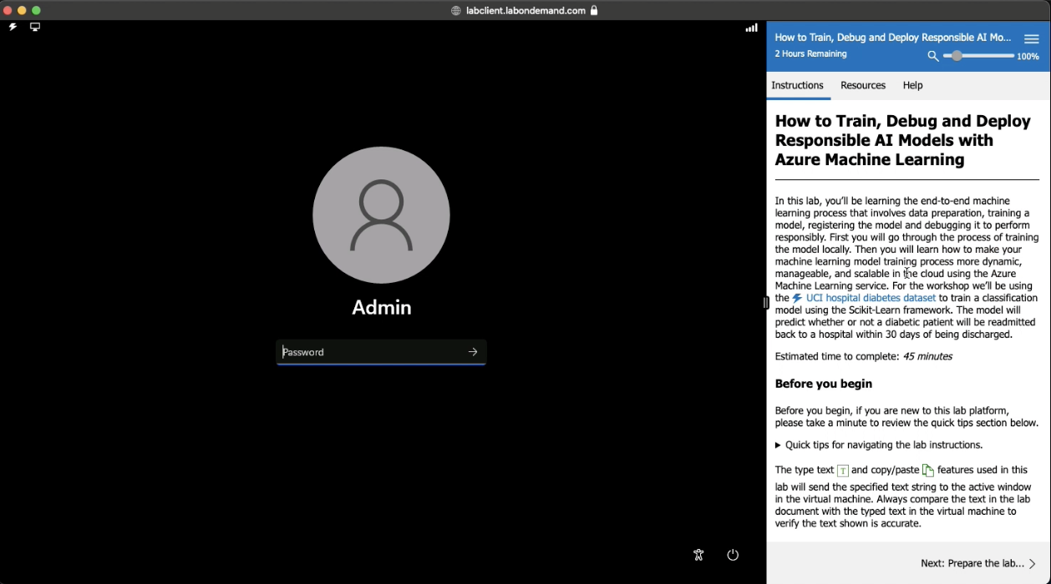
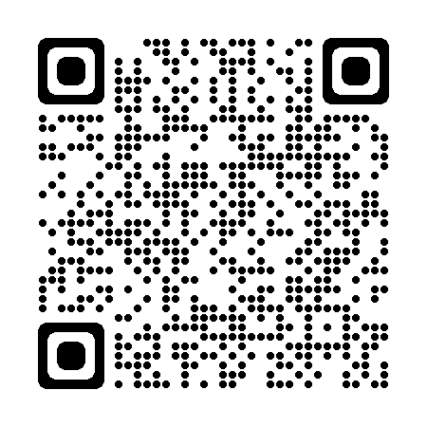
Stage 1 – Prepare Lab Environment
Get Familiar with VM Inputs, Instructions
Open VS Code & Log into Azure
Create Azure ML Workspace & save configuration to file
See Video | https://aka.ms/rai-hub/raidashboard-module-walkthrough
Notes:
The lab uses a platform that comes with a pre-configured Windows 11 virtual machine and a built-in instruction manual as shown. It also give you a temporary Azure subscription so you can work on the lab without any other pre-requisites.
Launch the lab and complete the “Prepare Lab Environment” section to get the attendees familiar with using the instruction manual. At the end of this section, you will have logged into Azure and setup an Azure Machine Learning workspace for today.

Slide 7
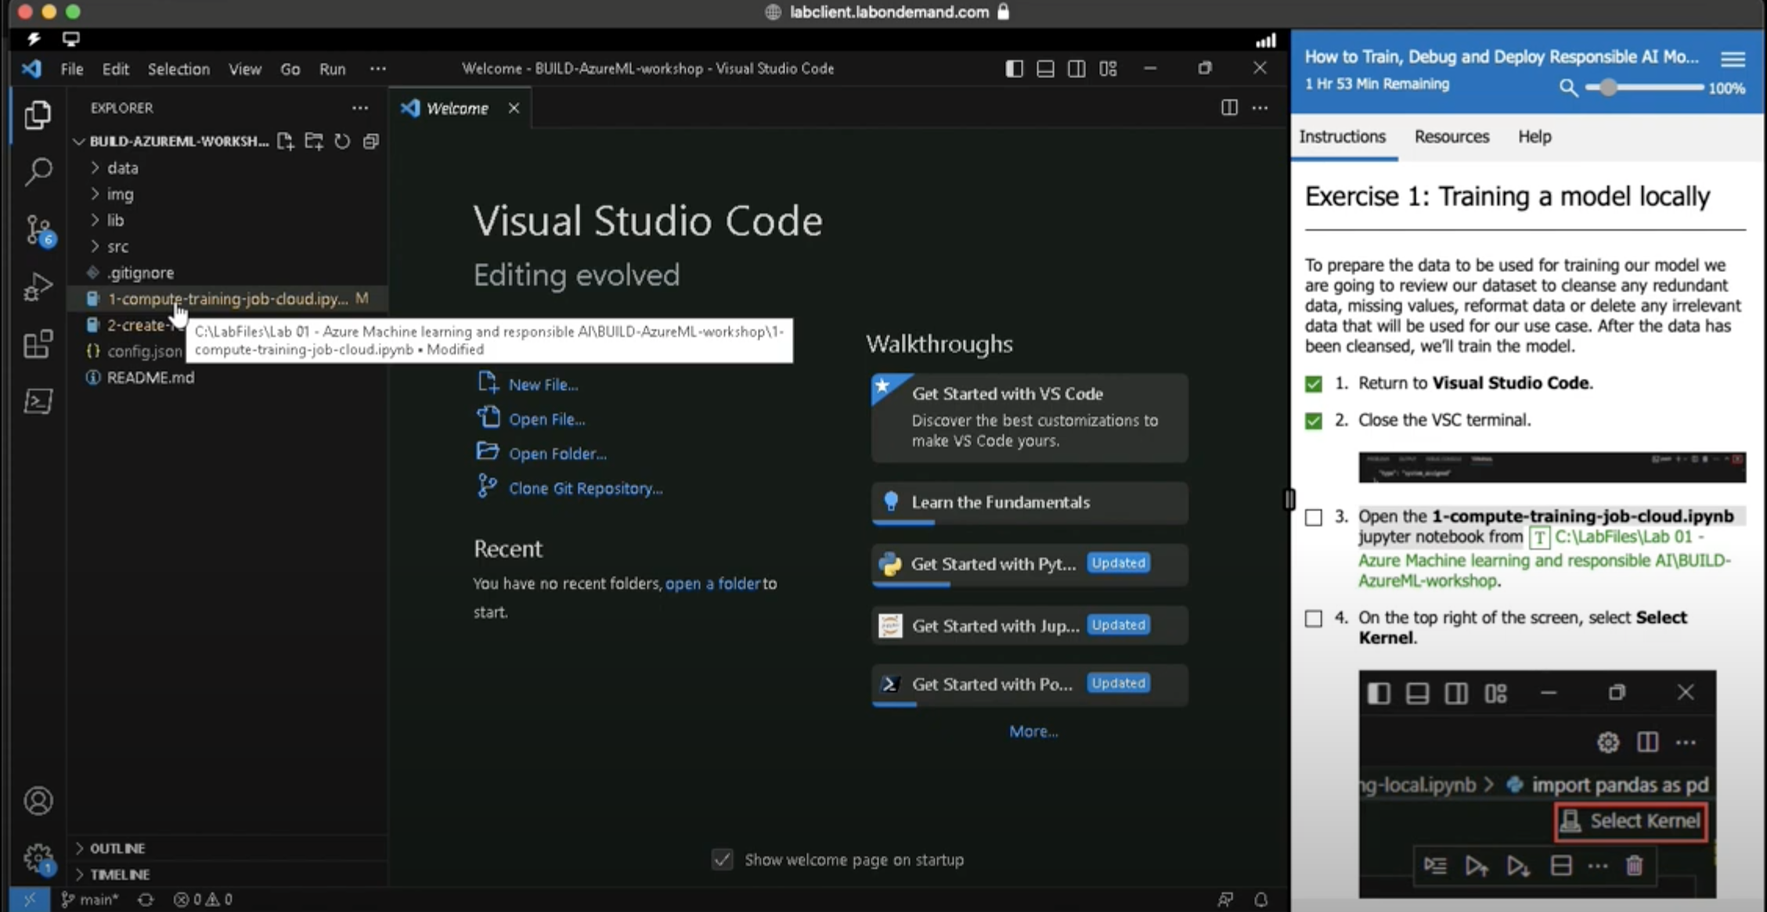
Stage 2 – Build & Register Your Model In Azure
Notebook 1
Configure Jupyter Notebook, then Run All to complete task
Open Azure ML Studio to track and verify completion
See Video | https://aka.ms/rai-hub/raidashboard-module-walkthrough
Notes:
Next, get the attendees to launch the first Jupyter Notebook, select the right kernel, and “Run All” to execute the code.
This will create the model and register it in Azure – but the process takes 10 minutes.
By doing this early, the attendees can now get the process going while they sit back and listen to the presentation about what they will learn.

Slide 8
3 | Error Analysis On A Model
4 | Find Model Performance Inconsistencies
5 | Expose Data Biases
7 | Complete Exercises – Prioritize Dashboard Section
8 | Knowledge Check
6 | Explain & Interpret Model
1 | Prepare The Lab – Launch & Run Notebooks Early
9 | Summary
2 | What is a Responsible AI Dashboard?
Notes:
Welcome to the Learn Session for the Responsible AI Dashboard. This is our agenda for today. The Learn Module is designed for 20 minutes of “concepts” and 45 minutes of “lab”
In the workshop format, we can follow this agenda to ensure attendees complete the lab within an hour.
[5 mins] Start the Lab Preparation early before reviewing concepts. Lab setup takes 10 minutes, so we can use that time to review concepts.
[10 mins] Review Concepts while attendees wait for setup to complete. Use the 2-minute video, or walk through the slides and explain them
[35 mins] Let attendees get back to their Labs and complete the exercises on their own.
[5 mins] Do the knowledge check to review understanding – or use time for Q&A or extra buffer
[5 mins] Wrap-up and provide badges, resources

Slide 9




The AI Landscape is Changing Fast
AI innovation is occurring at a rapid pace
AI adoption
is being accelerated by organizations
AI expectations are evolving within our societies
AI regulations are being debated by governments
We live in a data-driven world with growing demand for machine-learning models that perform efficiently and ethically for real users.
Notes:
The pace of AI innovation and adoption today is unprecedented.
Innovation happens on a daily basis thanks to open-source tools and communities Adoption is being accelerated by organizations delivering AI-driven solutions
Which in turn is raising user expectations (and concerns) that AI work reliably, safely and ethically.
And causing governments to define regulations to help safeguard public trust in these solutions.

Slide 10



Re
Practitioners Need to Operationalize Responsible AI
Data Scientists
Decision Makers
Application Developers
How can I debug my models, take business decisions with confidence, and gain user trust with my AI-driven solutions – at scale?
Notes:
AI practitioners now need tools and practices that can operationalize responsible AI practices, so they can keep up with changes.
Data scientists need ways to debug their models to make sure they work in a fair, reliable and safe manner.
Decision makers need to understand why AI decisions were made, so they can make informed decisions to get desirable outcomes
Application developers need to ensure they can quickly identify and mitigate issues at scale, to preserve user trust

Slide 11

Responsible AI Principles guide the approach to assessing, developing & deploying AI systems in safe, trustworthy & ethical ways.
Responsible AI Toolbox is a collection of integrated tools & functionalities to help operationalize Responsible AI in practice for data scientists, developers & decision-makers.
Responsible AI Dashboard Defined
Responsible AI Dashboard is a single pane of glass for holistic responsible assessment through stages of model debugging & decision-making
Reference: https://responsibleaitoolbox.ai
Notes:
To support this, Microsoft did 3 things:
- Define Responsible AI Principles that guide the approach to assessing, developing & deploying AI systems safely, reliably, and ethically.
- Created an open-source Toolbox that brings together an integrated collection of open-source tools (from Microsoft + Community) for operationalizing it.
- Developed a Responsible AI Dashboard to provide a single pane of glass for holistic assessment of your deployed model, using these tools

Slide 12
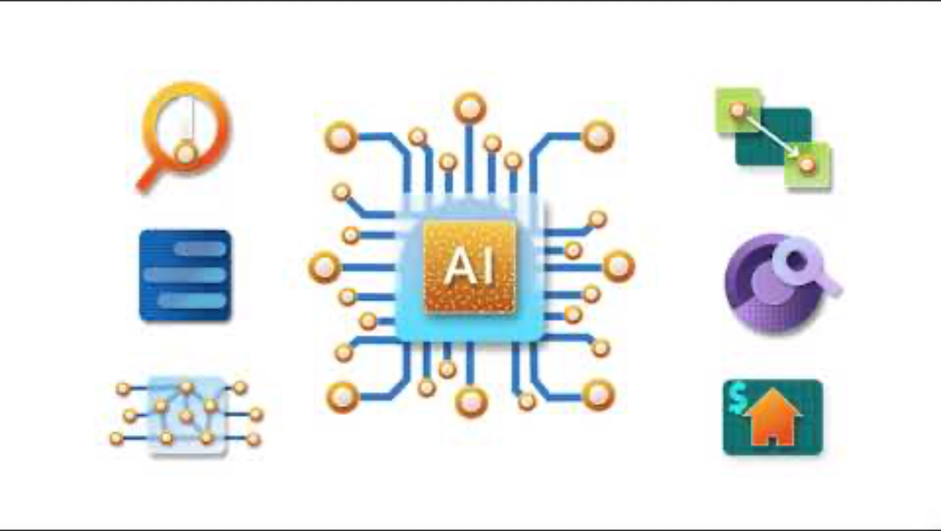
Responsible AI Dashboard Explained
Reference: YouTube Animated Responsible AI Explainer
Housing Demo: https://aka.ms/rai-dashboard
Notes:
This animated explained walks through

Slide 13
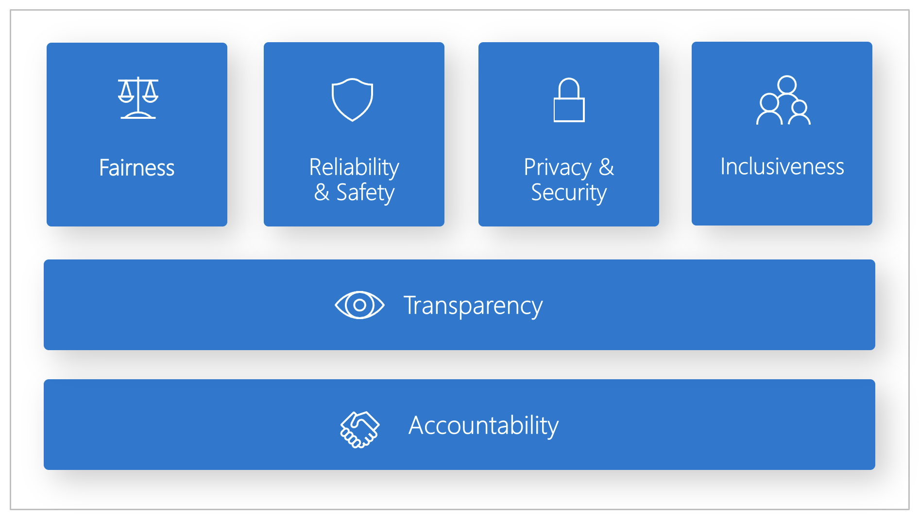
Responsible AI 6 Principles
Fairness – How might an AI system allocate opportunities in ways that are fair to the humans who use it?
Reliability & Safety – How might the system function well for people even in conditions it was not designed for?
Privacy & Security – How might the system be designed to preserve data privacy and security, compliant with laws?
Inclusiveness – How might an AI system be designed to be inclusive of people of all abilities (think accessibility)?
Transparency – How might people misunderstand, misuse or incorrectly estimate the capabilities of the AI System?
Accountability – How can we create oversight so that humans can be accountable and in control of AI behaviors?
Reference: https://www.microsoft.com/ai/principles-and-approach/

Slide 14
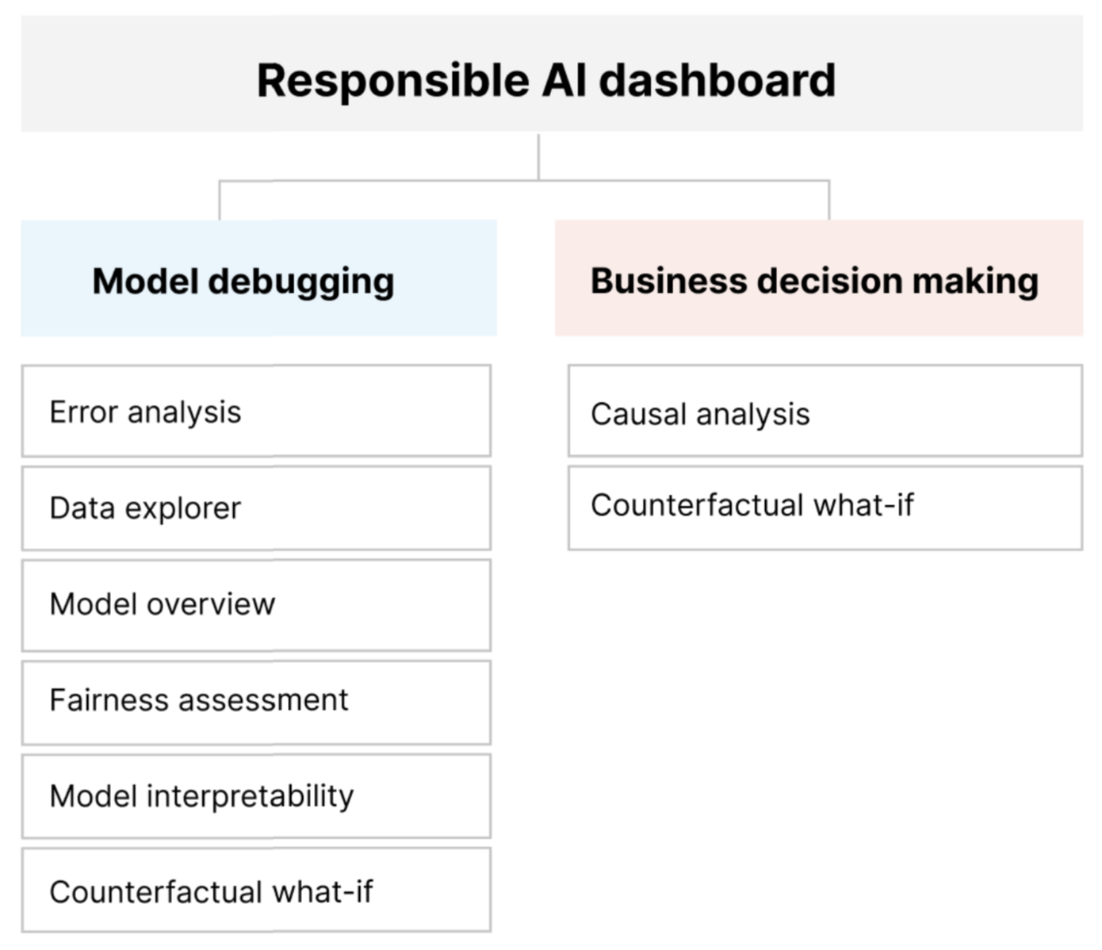
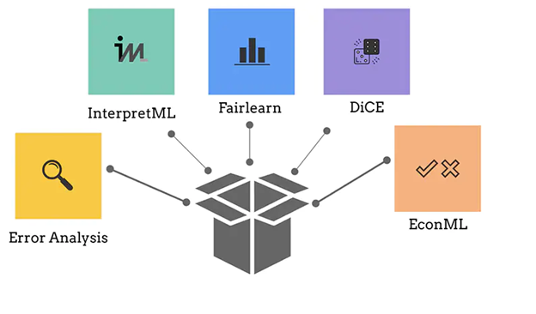
Error Analysis – Dive deep into how model failures are distributed across different ‘cohorts’ (based on inputs, features)
Data Explorer – Visualize datasets to understand issues of over- or under- representation in dataset, by cohorts or feature groups. Use it to conduct fairness assessments & identify areas for mitigation.
Model Overview – Understand how model performance varies by metrics or data subgroups in data. Decide first steps in debugging.
Interpretability – How trustworthy are AI predictions? Give human-friendly explainers for outcomes & features that influence it most
Counterfactuals/What-If – How might people misunderstand the AI system capabilities? How can they get a desirable outcome from it?
Causal Inference – Identify features with most direct effect on a desired outcome & estimate the impact from an intervention.
Responsible AI Dashboard Composable Components
Reference: https://responsibleaitoolbox.ai/introducing-responsible-ai-dashboard/#dashboard-components

Slide 15
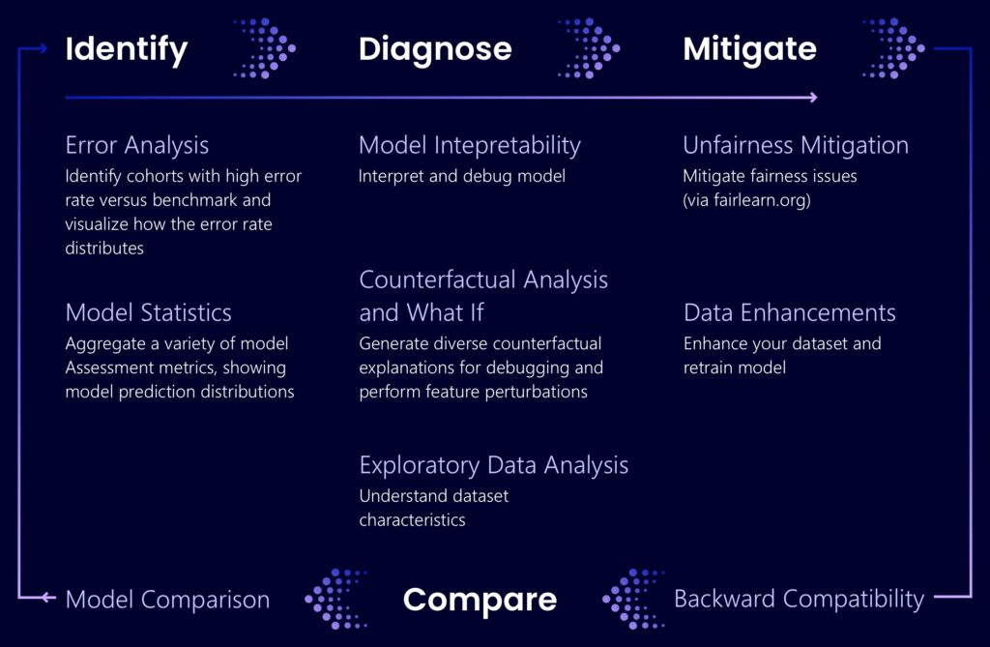
Step 1: Identify What kinds of errors does my model have? In which areas are they most prevalent?
Step 2: Diagnose What causes these errors? Where should I focus resources?
Step 3: Mitigate How can I improve the model? What social or technical solutions exist for it?
Responsible AI Dashboard Model Debugging
Reference: https://responsibleaitoolbox.ai/introducing-responsible-ai-dashboard

Slide 16
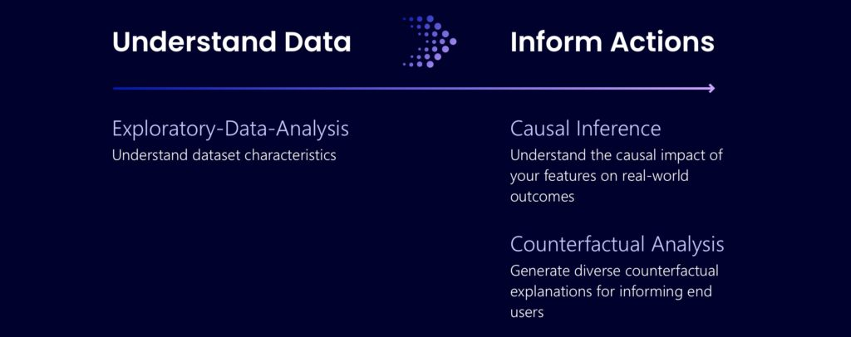
Inform Your Business Decisions
Data-Driven = Historical “How would a medicine impact the patient’s blood pressure?”
Model-Driven = Causal “What should I do to get a different outcome from your AI next time?”
Responsible AI Dashboard Decision Making
Reference: https://responsibleaitoolbox.ai/introducing-responsible-ai-dashboard/#decision-making

Slide 17
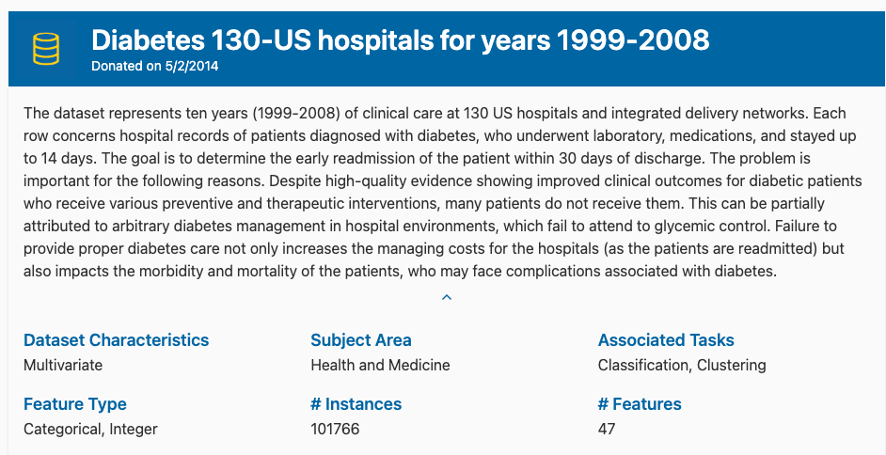
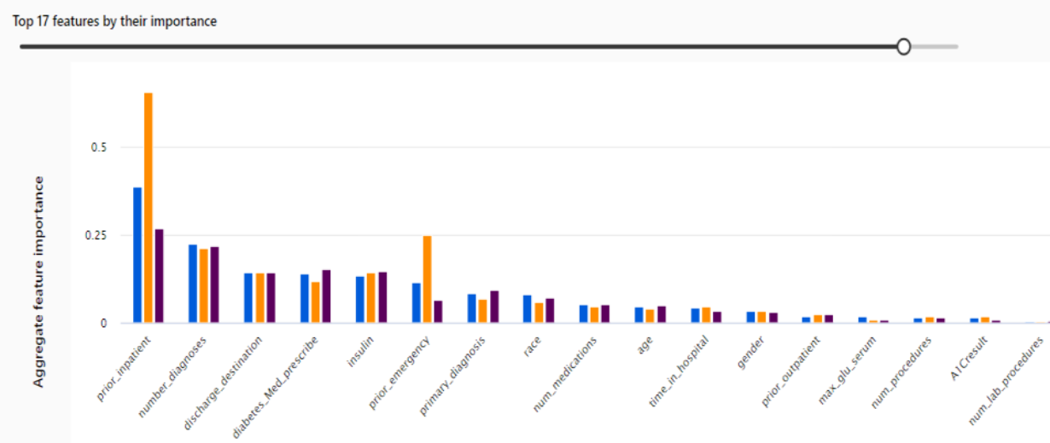
We’ll build & register a model based on the UCI Diabetes dataset which predicts if a diabetes patient will get readmitted within 30 days.
We’ll create a responsible AI dashboard & debug model using error analysis, model overview, data analysis & feature analysis tools.
Responsible AI Dashboard Training Today
Reference: https://archive.ics.uci.edu/dataset/296/diabetes+130-us+hospitals+for+years+1999-2008

Slide 18
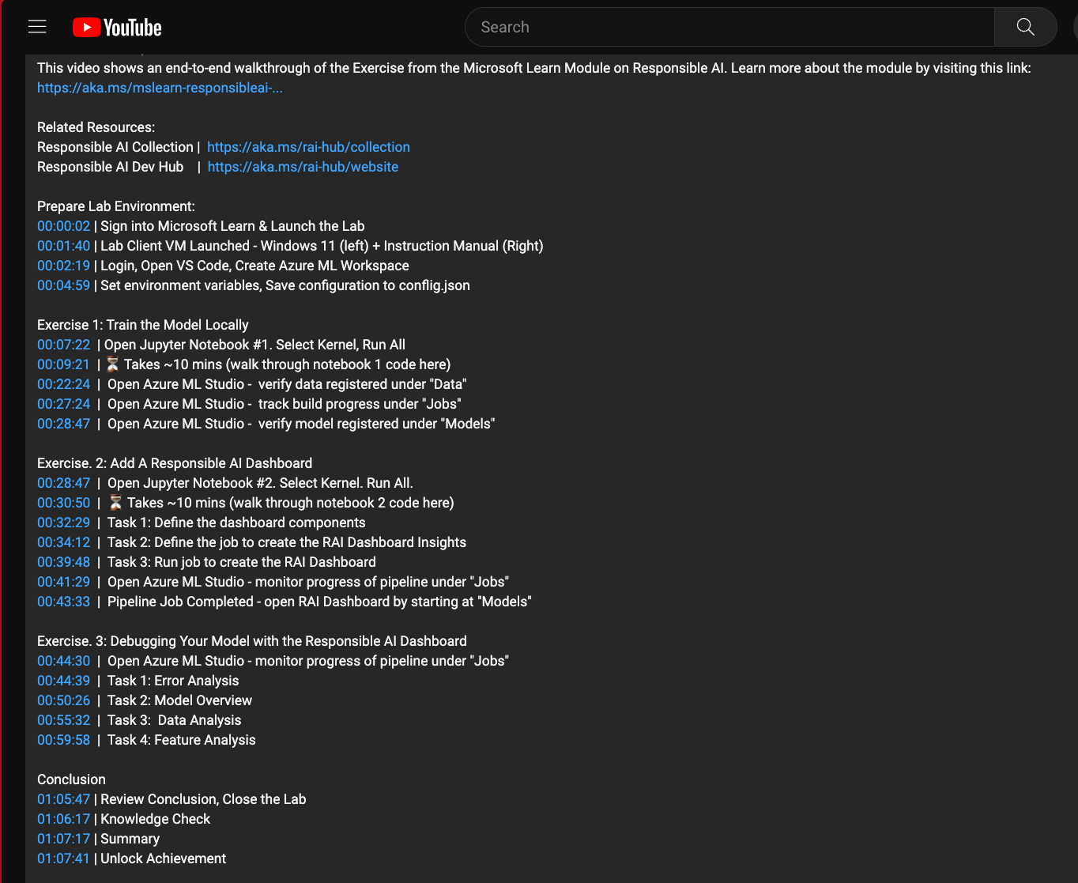
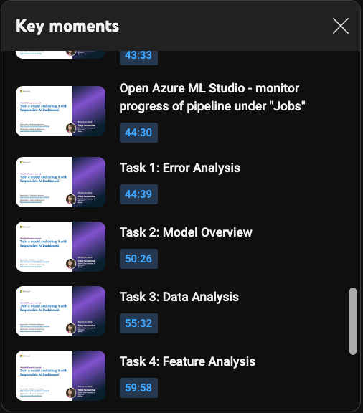
Use the video walkthrough as a reference or for a preview of lab
Check description for chapter timestamps to move quickly to the desired section of lab
Click “View all” to get a playlist view (Key Moments) of chapters
Responsible AI Dashboard Lab Video Walkthrough
Reference: https://aka.ms/rai-hub/raidashboard-module-walkthrough

Slide 19
3 | Error Analysis On A Model
4 | Find Model Performance Inconsistencies
5 | Expose Data Biases
7 | Complete Exercises – Prioritize Dashboard Section
8 | Knowledge Check
6 | Explain & Interpret Model
1 | Prepare The Lab – Launch & Run Notebooks Early
9 | Summary
2 | What is a Responsible AI Dashboard?
Notes:
Welcome to the Learn Session for the Responsible AI Dashboard. This is our agenda for today. The Learn Module is designed for 20 minutes of “concepts” and 45 minutes of “lab”
In the workshop format, we can follow this agenda to ensure attendees complete the lab within an hour.
[5 mins] Start the Lab Preparation early before reviewing concepts. Lab setup takes 10 minutes, so we can use that time to review concepts.
[10 mins] Review Concepts while attendees wait for setup to complete. Use the 2-minute video, or walk through the slides and explain them
[35 mins] Let attendees get back to their Labs and complete the exercises on their own.
[5 mins] Do the knowledge check to review understanding – or use time for Q&A or extra buffer
[5 mins] Wrap-up and provide badges, resources

Slide 20




Lab Exercise: What We Will Do Today
Notebook 2
🚀
Notebook 1
Build & Train an ML Model for the UCI Diabetes Dataset
Create a Responsible AI Dashboard with specific components, for the model.
Create AML Workspace & register model in Azure ML Studio for use
Use the dashboard to debug the model using various tools, in an intuitive workflow.
We’ll use a dataset of diabetes patient records to build & register a model that predicts if a patient will be readmitted within 30 days of discharge.
We’ll assess model for responsible AI practices by using the error analysis, model overview, data analysis & feature analysis components for insights
Notes:
In the lab later in this module, we'll be using the UCI hospital diabetes dataset to train a classification model using the Scikit-Learn framework. The model will predict whether or not a diabetic patient will be readmitted back to a hospital within 30 days of being discharged.

Slide 21
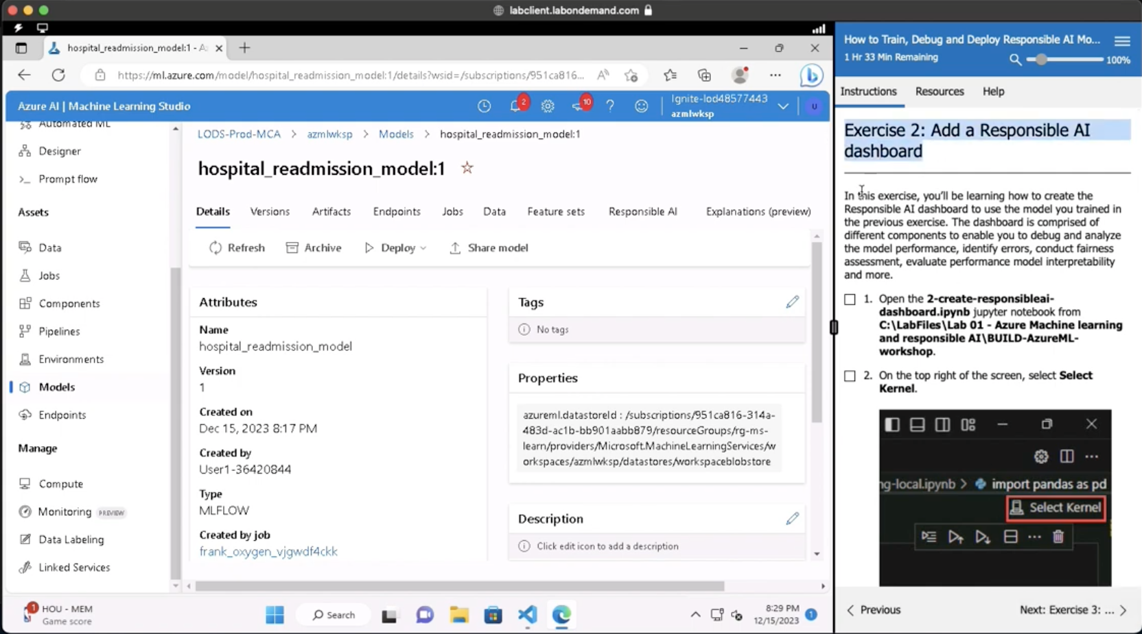
Stage 3 – Add Responsible AI Dashboard To Model
Notebook 2
Configure Jupyter Notebook, then Run All to complete task
Open Azure ML Studio and open the RAI Dashboard tab
See Video | https://aka.ms/rai-hub/raidashboard-module-walkthrough

Slide 22
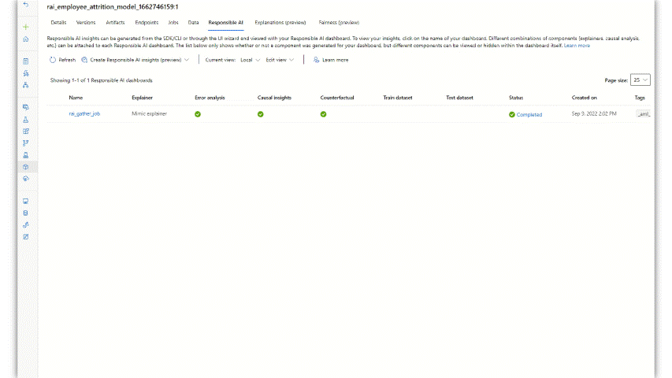
Azure ML Studio: Responsible AI Dashboard View
Notebook 2
Configure Jupyter Notebook, then Run All to complete task
Open Azure ML Studio and open the RAI Dashboard tab
See Video | https://aka.ms/rai-hub/raidashboard-module-walkthrough

Slide 23
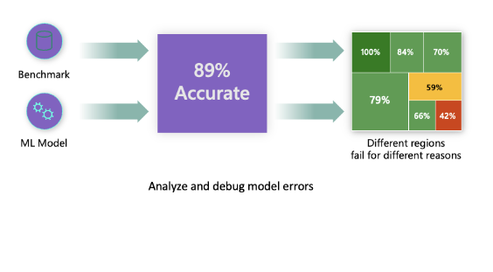
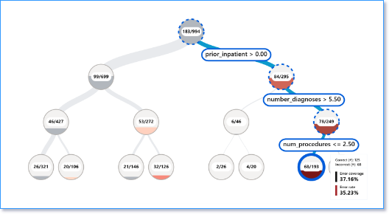
Task: Error analysis on a model
Traditional performance metrics for machine learning models focus on calculations based on correct vs incorrect predictions.
Error distribution
Error Analysis -dashboard
Notes:
The overall performance metrics such as classification’s accuracy, precision, recall or FI scores are good proxies to help you build trust with your model. However, further analysis and assessment is needed.
Errors are often not distributed uniformly in your underlying dataset. For instance, you may get an 89% model accuracy, but you might discover that when you dive deeper, you realize that there are different regions of your data for which the model is failing 58% of the times. That’s where having the Error Analysis tool is crucial.
Aggregated model performance metrics are not enough
Errors not uniformly distributed in the dataset
Different regions of the data may be causing the model to fail
Traditional performance metrics for machine learning models focus on calculations based on correct vs incorrect predictions. The aggregated accuracy scores or average error loss show how good the model is, but don't reveal conditions causing model errors. While the overall performance metrics such as classification accuracy, precision, recall or Mean Absolute Error (MAE) scores are good proxies to help you build trust with your model, they're insufficient in locating where in the data the model has inaccuracies. Often, model errors aren't distributed uniformly in your underlying dataset. For instance, if your model is 89% accurate, does that mean it's 89% fair as well?
Model fairness and model accuracy aren't the same thing and must be considered. Unless you take a deep dive in the model error distribution, it would be challenging to discover the different regions of your data for where the model is failing 42% of the time (see the red region in diagram below). The consequence of having errors in certain data groups can lead to fairness or reliability issues. To illustrate, the data group with the high number of errors might contain sensitive features such as age, gender, disabilities, or ethnicity. Further analysis could reveal that the model has a high error rate with individuals with disabilities compared to ones without disabilities. So, it's essential to understand areas where the model is performing well or not, because the data regions where there are a high number of inaccuracies in your model might turn out to be an important data demographic you can't afford to ignore.
This is where the error analysis component of Azure Machine Learning Responsible AI dashboard helps in identifying a model's error distribution across its test dataset. Throughout this module we'll be using the diabetes hospital readmission classification model scenario to learn and explain the responsible AI dashboard. Later in the lab, you'll train and create your own dashboard using the same dataset.
​

Slide 24
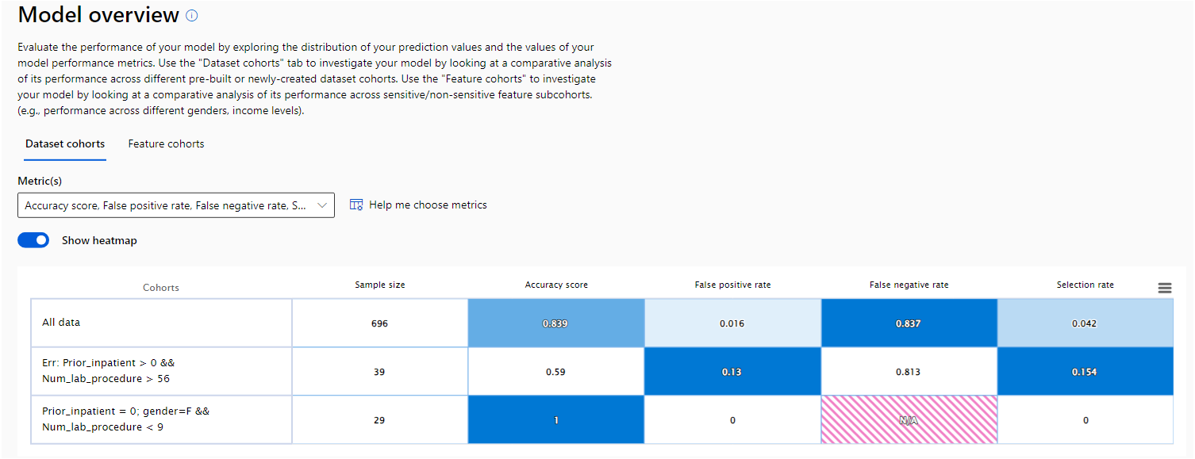
Task: Model performance inconsistencies
An effective approach to evaluating the performance of machine learning models is getting a holistic understanding of their behavior across different scenarios.
Disparities among performance metric
Showing how model is performing for a given cohort using metrics such as Accuracy, Precision, Recall, MAE, RSME etc.
Probability distribution
Showing the probability of a given cohort to fall in a model's predicted outcome.
Metric visualization
Showing performance scores for cohort.
Model Overview dashboard
Notes:
The RAI dashboard gives users the ability to do comparative analysis to help shed light on how the model is performing with one subgroup of the dataset vs another.
For example, discovering that the model is more erroneous with one group or cohort that has sensitive features (e.g., patient race, gender, or age) can help expose potential unfairness the model may have.
This provides the ability to do comparative analysis to discover how the model is performing with one cohort vs another.
Disparity in model performance: These sets of metrics calculate the disparity (difference) in the values of the selected performance metric across subgroups of data. Here are a few examples:
•Disparity in accuracy rate
•Disparity in error rate
•Disparity in precision
•Disparity in recall
•Disparity in mean absolute error (MAE)
For example, the accuracy maybe be 84%, but the recall is 40%. The recall will show the percentage rate of that the model made, which were correct. So, you can see that there is a disparity or inconsistency between accuracy and recall, so the model is not reliable.
------
Comparative analysis shines a light on how models are performing for one subgroup of the dataset versus another. One of the advantages is that the model overview component of the Responsible AI dashboard isn't just reliant on high-level numeric calculations on datasets, it dives down to the data features as well. This is especially important when one cohort has certain unique characteristics compared to another cohort. For instance, discovering that the model is more erroneous with a cohort that has sensitive features such as race, gender, age, religion, political affiliation etc.) can help expose potential unfairness.
The model overview component provides a comprehensive set of performance and fairness metrics for evaluating your model, along with key performance disparity metrics along specified features and dataset cohorts.
The Model Overview component within the Responsible AI dashboard helps analyze model performance metric disparities across different data cohorts that the user creates.
Model fairness is quantified through disparity metrics during the analysis process.

Slide 25

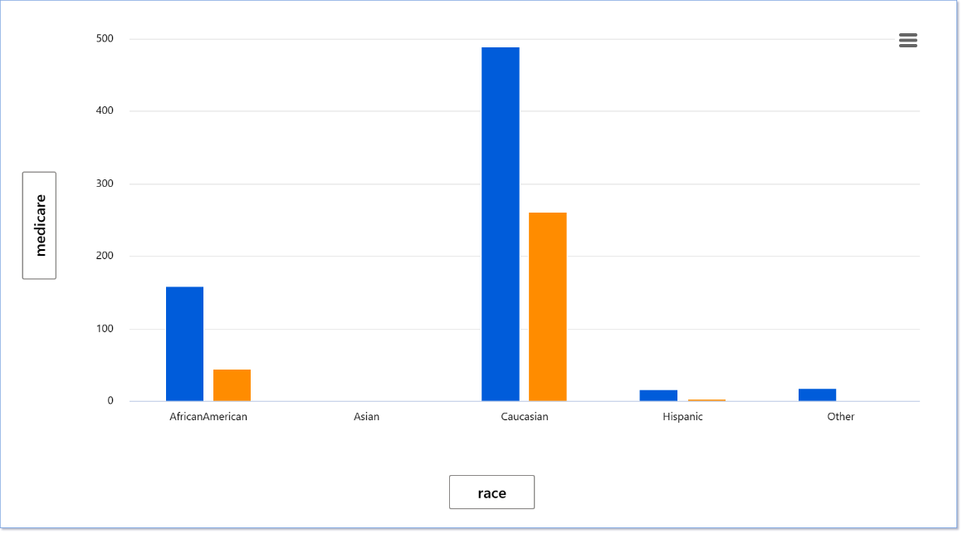
Task: Expose data biases
A major blind-spot and a very important part of model behavior is the actual data
.
Over/Under/Lack of Representation
Data Analysis dashboard
Notes:
The Azure Responsible AI dashboard includes a Data Analysis section for users to be able to explore and understand the dataset distributions and statistics. It provides an interactive user interface (UI) to enable users to visualize datasets based on the predicted and actual outcomes, error groups, and specific features. This is useful for ML professionals to be able to debug and identify issues of data over- and under-representation and to see how data is clustered in the dataset. As a result, they can understand the root cause of errors and any fairness issues introduced via data imbalances or lack of representation of a particular data group.
Overrepresented or Underrepresented data This leads to data biases causing the model to have fairness, inclusiveness, safety, or reliability issues.
Data quality Examining data representation across cohorts can reveal errors that come from representation issues, label noise, feature noise, label bias, and similar factors.
Data isolation behavior Explore your dataset statistics by selecting different filters to slice your data into different subgroups (cohorts)
The traditional method of evaluating the trustworthiness of a model's performance is to look at calculated metrics such as accuracy, recall, precision, root mean squared error (RSME), mean absolute error (MAE), or R² depending on the type of use-case you have (for example, classification or regression). Data scientists and AI developers can also measure confidence levels for areas the model correctly predicted or the frequency of making correct predictions. You can also try to isolate your test data in separate cohorts to observe and compare how the model performs with some groups vs. others. However, all of these techniques ignore a major blind spot: the underlying data.
Data can be overrepresented in some cases and underrepresented in others. This might lead to data biases, causing the model to have fairness, inclusiveness, safety, and/or reliability issues.

Slide 26
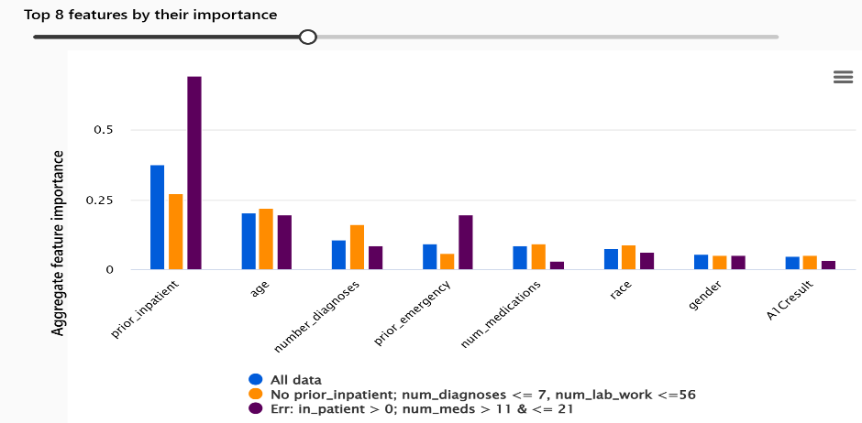
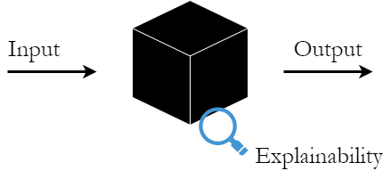
Task: Explain and interpret a model
Assessing a model isn't just about understanding how accurately it can make a prediction, but also why it made the prediction.
Model debugging: Why did my model make this mistake? How can I improve my model?
Human-AI collaboration: How can I understand and trust the model's decisions?
Regulatory compliance: Does my model satisfy legal requirements?
Blackbox – hard to understand
Explain model behavior - dashboard
Notes:
The feature importance component provides an interactive user interface (UI) that enables data scientists or AI developers to see the top features in their dataset that influence their model's prediction. In addition, it provides both global explanations and local explanations. With global explanations, the dashboard displays the top features that affect the model's overall predictions. For local explanations, it shows which features most influenced a prediction for an individual data point. For example, Marc and his wife Sarah are financially stable and share a bank account and both have good credit scores. Marc gets approved for a business loan, but Sarah is rejected. If the Responsible AI dashboard exposes that the top feature that drove loan approval model is sensitive features such as: age, gender, or race. Then we'll know that the loan has gender bias.
The RAI dashboard gives users the ability to understand and explain a model’s behavior for transparency and accountability. Users can see the top features driving the model’s predictions.
When you're using machine learning models in ways that affect people’s lives, it's critically important to understand what influences the behavior of models. Interpretability helps answer questions in scenarios such as:
Model debugging: Why did my model make this mistake? How can I improve my model?
Human-AI collaboration: How can I understand and trust the model’s decisions?
Regulatory compliance: Does my model satisfy legal requirements? By using the feature importance component, you can see which features were most important in your model's predictions. ============================= Assessing a model isn't just about understanding how accurately it can make a prediction, but also why it made the prediction. Understanding a model's behavior is a critical part of debugging and helps drive responsible outputs. By evaluating which data features are driving a model's prediction, you can identify if they're acceptable sensitive or nonsensitive features to base a decision on. In addition, being able to explain a model's outcome provides shared understanding for data scientists, decision-makers, end-users and auditors. Some industries have compliance regulations that require organizations to provide an explanation for how and why a model made the prediction it did. If an AI system is driving the decision-making, then data scientists need to specify the data features driving the model to make a prediction.

Slide 27
3 | Error Analysis On A Model
4 | Find Model Performance Inconsistencies
5 | Expose Data Biases
7 | Complete Exercises – Prioritize Dashboard Section
8 | Knowledge Check
6 | Explain & Interpret Model
1 | Prepare The Lab – Launch & Run Notebooks Early
9 | Summary
2 | What is a Responsible AI Dashboard?
Notes:
Welcome to the Learn Session for the Responsible AI Dashboard. This is our agenda for today. The Learn Module is designed for 20 minutes of “concepts” and 45 minutes of “lab”
In the workshop format, we can follow this agenda to ensure attendees complete the lab within an hour.
[5 mins] Start the Lab Preparation early before reviewing concepts. Lab setup takes 10 minutes, so we can use that time to review concepts.
[10 mins] Review Concepts while attendees wait for setup to complete. Use the 2-minute video, or walk through the slides and explain them
[35 mins] Let attendees get back to their Labs and complete the exercises on their own.
[5 mins] Do the knowledge check to review understanding – or use time for Q&A or extra buffer
[5 mins] Wrap-up and provide badges, resources

Slide 28


Lab Exercise: What We Will Do Today
Notebook 1
Notebook 2
Build & Train an ML Model for the UCI Diabetes Dataset
Create a Responsible AI Dashboard with specific components, for the model.
Create AML Workspace & register model in Azure ML Studio for use
Use the dashboard to debug the model using various tools, in an intuitive workflow.
🚀
We’ll use a dataset of diabetes patient records to build & register a model that predicts if a patient will be readmitted within 30 days of discharge.
We’ll assess model for responsible AI practices by using the error analysis, model overview, data analysis & feature analysis components for insights
Notes:
In the lab later in this module, we'll be using the UCI hospital diabetes dataset to train a classification model using the Scikit-Learn framework. The model will predict whether or not a diabetic patient will be readmitted back to a hospital within 30 days of being discharged.

Slide 29
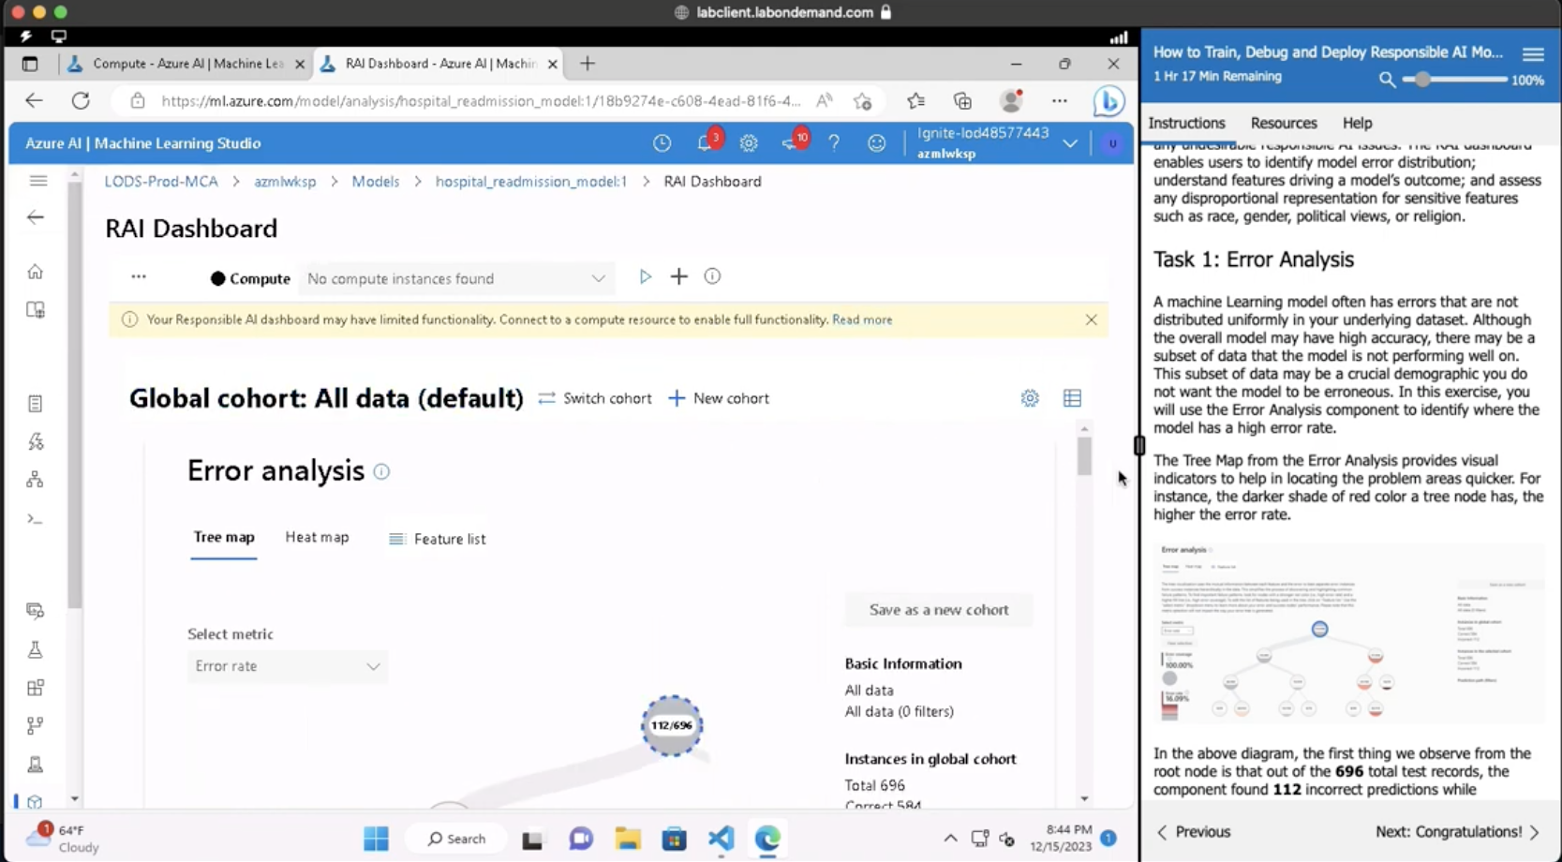
Stage 4 – Debug Model Using The RAI Dashboard
Azure ML Studio
Minimize sidebar to see full dashboard
Walk through four dashboard tasks to debug model & assess compliance
See Video | https://aka.ms/rai-hub/raidashboard-module-walkthrough

Slide 30
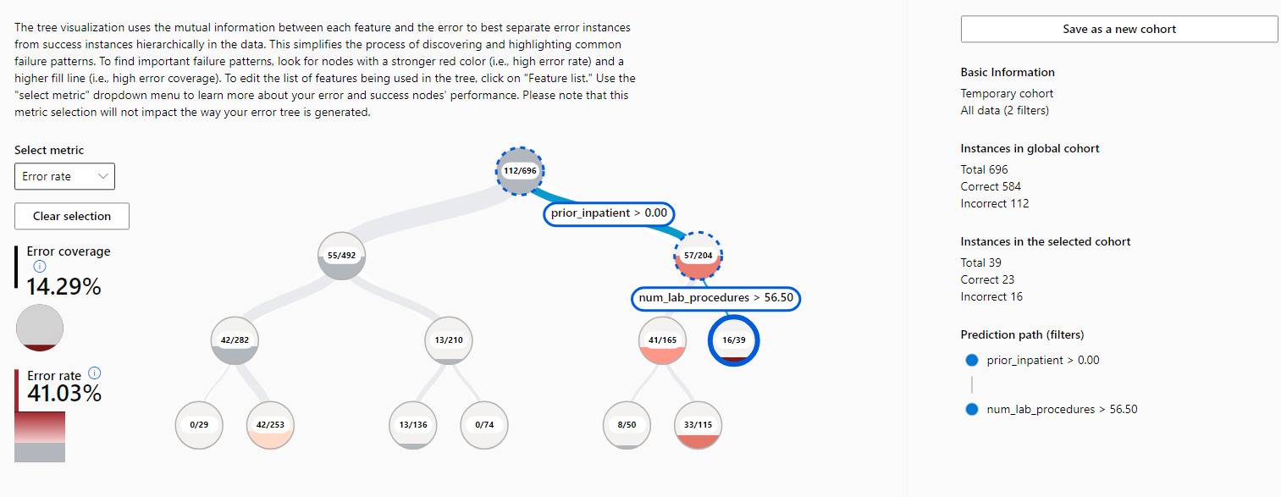
Task 1: Error Analysis
See Video | https://aka.ms/rai-hub/raidashboard-module-walkthrough

Slide 31
Task 2: Model Overview
See Video | https://aka.ms/rai-hub/raidashboard-module-walkthrough

Slide 32
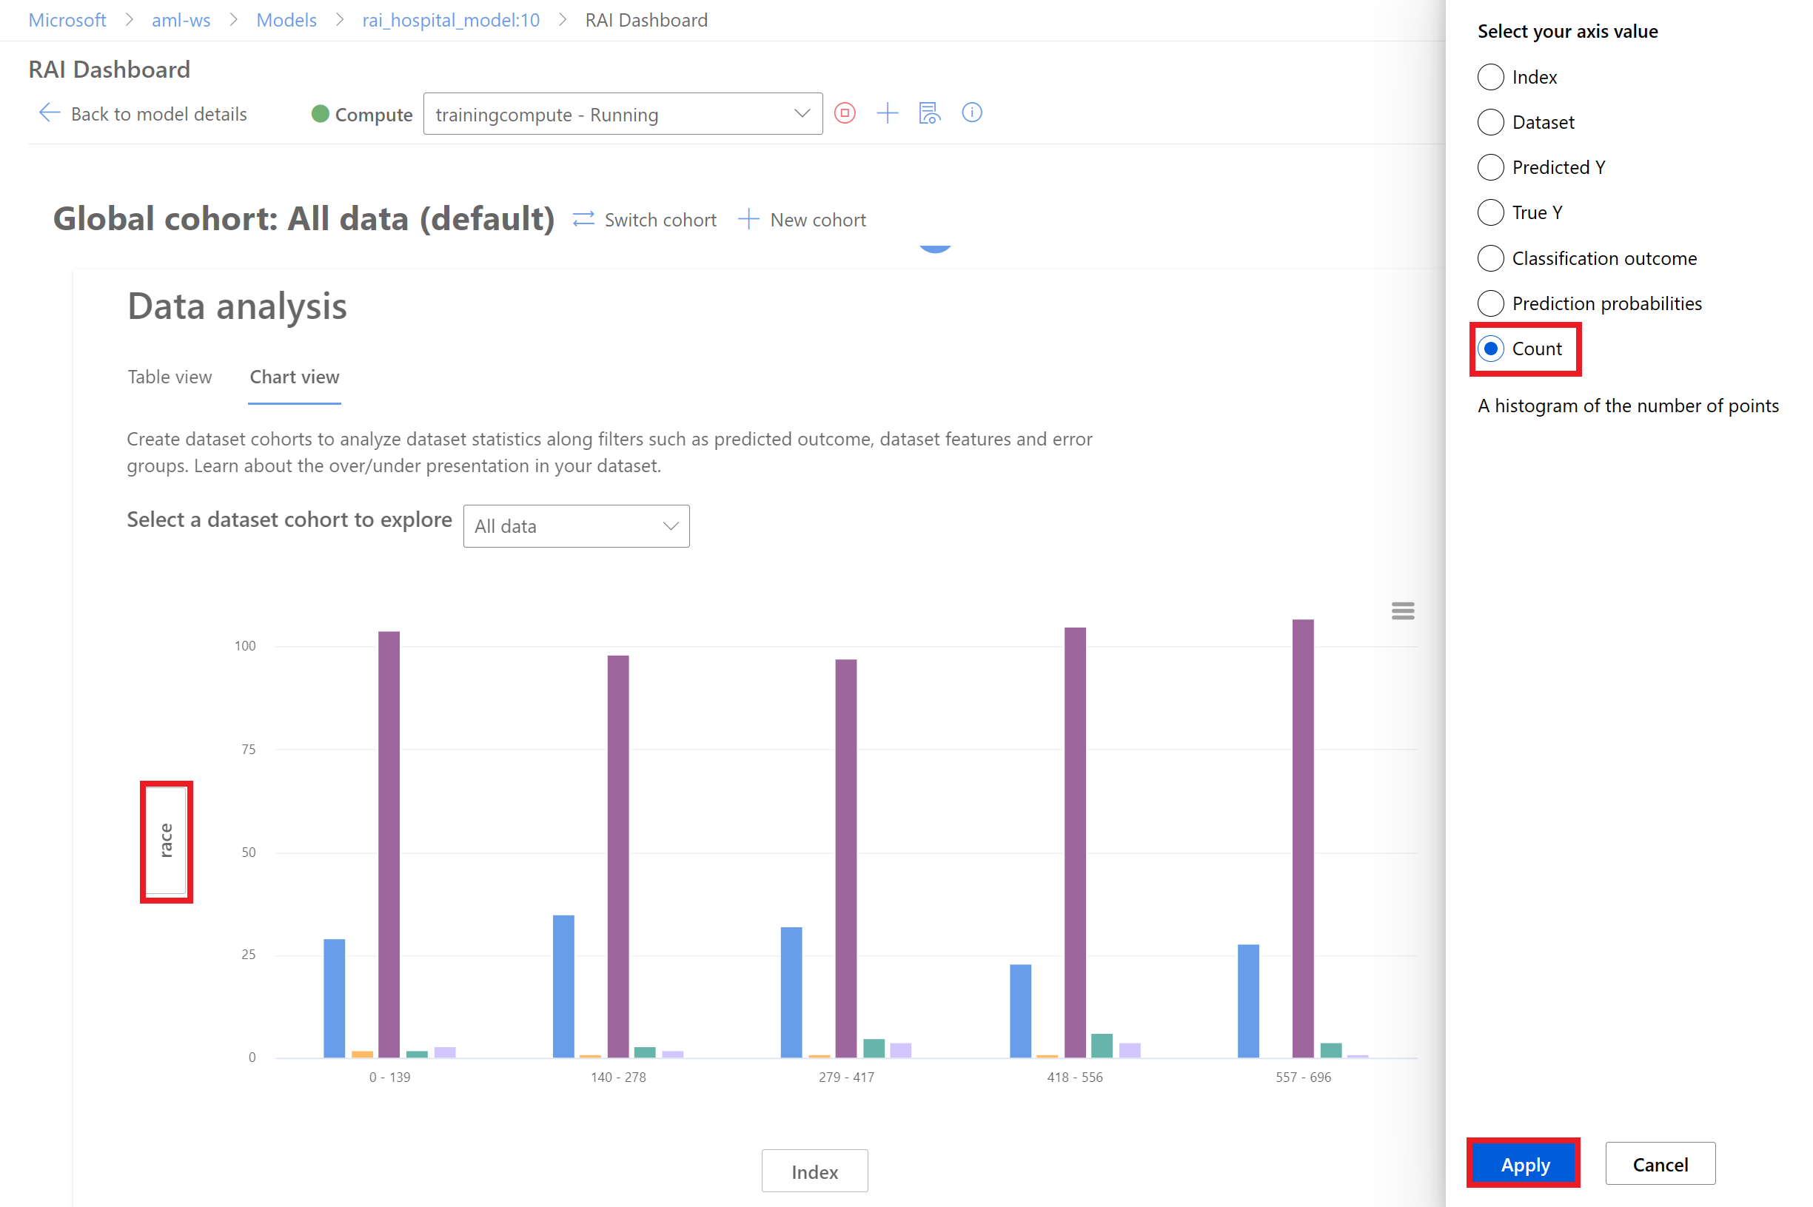
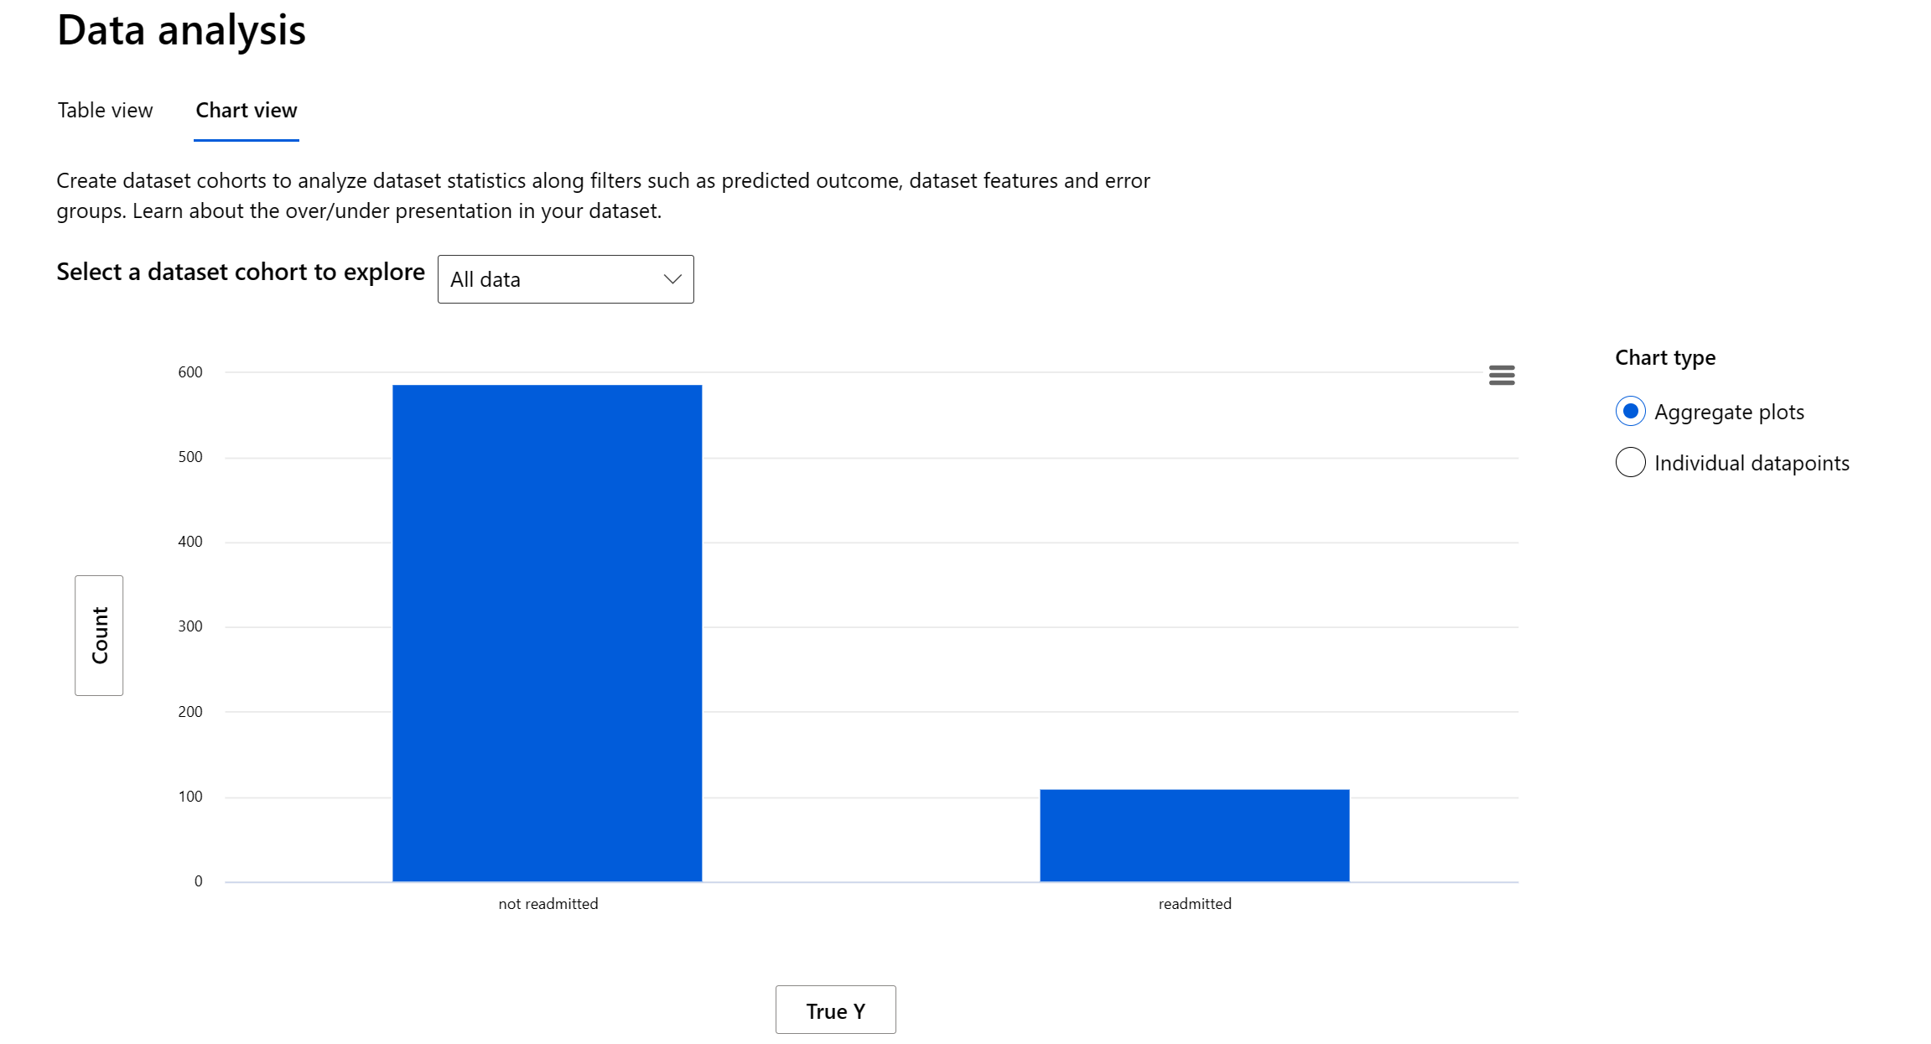
Task 3: Data Analysis
See Video | https://aka.ms/rai-hub/raidashboard-module-walkthrough

Slide 33
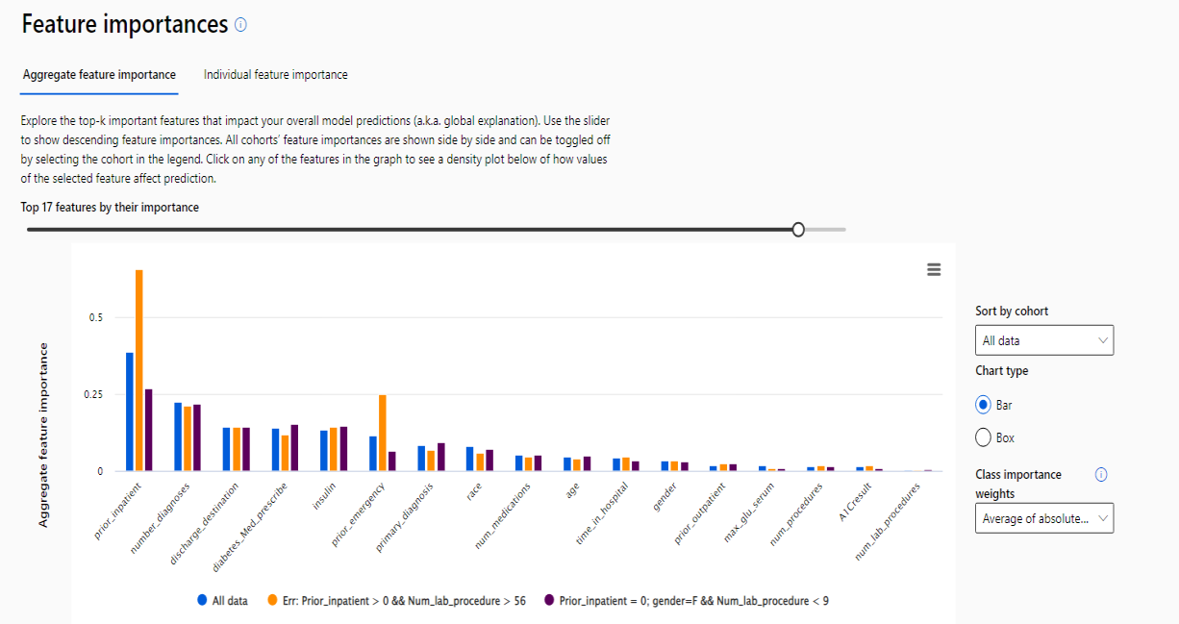
Task 4: Feature Importances
See Video | https://aka.ms/rai-hub/raidashboard-module-walkthrough

Slide 34
3 | Error Analysis On A Model
4 | Find Model Performance Inconsistencies
5 | Expose Data Biases
7 | Complete Exercises – Prioritize Dashboard Section
8 | Knowledge Check
6 | Explain & Interpret Model
1 | Prepare The Lab – Launch & Run Notebooks Early
9 | Summary
2 | What is a Responsible AI Dashboard?
Notes:
Welcome to the Learn Session for the Responsible AI Dashboard. This is our agenda for today. The Learn Module is designed for 20 minutes of “concepts” and 45 minutes of “lab”
In the workshop format, we can follow this agenda to ensure attendees complete the lab within an hour.
[5 mins] Start the Lab Preparation early before reviewing concepts. Lab setup takes 10 minutes, so we can use that time to review concepts.
[10 mins] Review Concepts while attendees wait for setup to complete. Use the 2-minute video, or walk through the slides and explain them
[35 mins] Let attendees get back to their Labs and complete the exercises on their own.
[5 mins] Do the knowledge check to review understanding – or use time for Q&A or extra buffer
[5 mins] Wrap-up and provide badges, resources

Slide 35
Question 1
After successfully running a training job, what is the final step in the workflow to make the trained model available for future predictions?
A. Register the model.
B. Create a new job.
C. Transform the model.
D. Delete the compute cluster.
Vote at <LINK>
Notes:
Explanation: Correct. Registering the model is the final step to make the trained model available for future predictions, allowing it to be accessed and utilized in various applications.

Slide 36
Question 1
After successfully running a training job, what is the final step in the workflow to make the trained model available for future predictions?
A. Register the model.
B. Create a new job.
C. Transform the model.
D. Delete the compute cluster.
Vote at <LINK>
Notes:
Explanation: Correct. Registering the model is the final step to make the trained model available for future predictions, allowing it to be accessed and utilized in various applications.

Slide 37
Question 2
What does the feature importance component in the responsible AI dashboard creation process do?
A. It configures the overall and feature error rates.
B. It calculates error distributions.
C. It initializes the global data for the components.
D. It provides a better understanding of what features influence the model's predictions.
Vote at <LINK>
Notes:
Explanation: The feature importance component helps users understand how different features affect the model's predictions.

Slide 38
Question 2
What does the feature importance component in the responsible AI dashboard creation process do?
A. It configures the overall and feature error rates.
B. It calculates error distributions.
C. It initializes the global data for the components.
D. It provides a better understanding of what features influence the model's predictions.
Vote at <LINK>
Notes:
Explanation: The feature importance component helps users understand how different features affect the model's predictions.

Slide 39
Question 3
Why is data imbalance in the test dataset a concern when using machine learning models?
A. It increases model accuracy.
B. It makes model evaluation easier.
C. It might lead to fairness and inclusiveness issues.
D. It has no impact on model performance.
Vote at <LINK>
Notes:
Explanation: Correct. Data imbalance can lead to fairness and inclusiveness issues as the model might not perform well on underrepresented groups.

Slide 40
Question 3
Why is data imbalance in the test dataset a concern when using machine learning models?
A. It increases model accuracy.
B. It makes model evaluation easier.
C. It might lead to fairness and inclusiveness issues.
D. It has no impact on model performance.
Vote at <LINK>
Notes:
Explanation: Correct. Data imbalance can lead to fairness and inclusiveness issues as the model might not perform well on underrepresented groups.

Slide 41
3 | Error Analysis On A Model
4 | Find Model Performance Inconsistencies
5 | Expose Data Biases
7 | Complete Exercises – Prioritize Dashboard Section
8 | Knowledge Check
6 | Explain & Interpret Model
1 | Prepare The Lab – Launch & Run Notebooks Early
9 | Summary
2 | What is a Responsible AI Dashboard?
Notes:
Welcome to the Learn Session for the Responsible AI Dashboard. This is our agenda for today. The Learn Module is designed for 20 minutes of “concepts” and 45 minutes of “lab”
In the workshop format, we can follow this agenda to ensure attendees complete the lab within an hour.
[5 mins] Start the Lab Preparation early before reviewing concepts. Lab setup takes 10 minutes, so we can use that time to review concepts.
[10 mins] Review Concepts while attendees wait for setup to complete. Use the 2-minute video, or walk through the slides and explain them
[35 mins] Let attendees get back to their Labs and complete the exercises on their own.
[5 mins] Do the knowledge check to review understanding – or use time for Q&A or extra buffer
[5 mins] Wrap-up and provide badges, resources

Slide 42
Model Debugging: What We Learned Today
When we train a machine learning model, we want it to learn or uncover patterns.
Create a Responsible AI dashboard.
Identify where the model has errors.
Discover data over or under representation to mitigate biases.
Understand what drives a model outcome with explainable and interpretability.
Mitigate issues to meet compliance regulation requirements.
Notes:
When we train a machine learning model, we want the model to learn or uncover patterns. We focus on how accurately a model can make predictions and try to reduce the error rate of the model. However, by focusing too much on aggregated model performance metrics, we often neglect to evaluate human-centric factors that impact people or society. The Responsible AI dashboard enables users to be able to identify areas where the model outcomes are erroneous and uncover blind spots that could lead to data bias or undesirable behaviors. The dashboard aims to help make your AI model less harmful and make it easier to understand what is driving its predictions.
In this module, you've learned how to:
Create a Responsible AI dashboard.
Identify where the model has errors.
Discover data over or under representation to mitigate biases.
Understand what drives a model outcome with explainable and interpretability.
Mitigate issues to meet compliance regulation requirements.

Slide 43
Lab Exercise: What We Did Today
Notebook 1
🚀
Notebook 2
Build & Train an ML Model for the UCI Diabetes Dataset
Create a Responsible AI Dashboard with specific components, for the model.
Create AML Workspace & register model in Azure ML Studio for use
Use the dashboard to debug the model using various tools, in an intuitive workflow.
We’ll use a dataset of diabetes patient records to build & register a model that predicts if a patient will be readmitted within 30 days of discharge.
We’ll assess model for responsible AI practices by using the error analysis, model overview, data analysis & feature analysis components for insights
Notes:
In the lab later in this module, we'll be using the UCI hospital diabetes dataset to train a classification model using the Scikit-Learn framework. The model will predict whether or not a diabetic patient will be readmitted back to a hospital within 30 days of being discharged.

Slide 44
Use the video walkthrough as a reference or for a preview of lab
Check description for chapter timestamps to move quickly to the desired section of lab
Click “View all” to get a playlist view (Key Moments) of chapters
Responsible AI Dashboard Lab Video Walkthrough
Reference: https://aka.ms/rai-hub/raidashboard-module-walkthrough

